Slide 1
Georgia Tech's Computational Photography
Portfolio
Deliang Yin
deliang.yin@gatech.edu

Slide 2
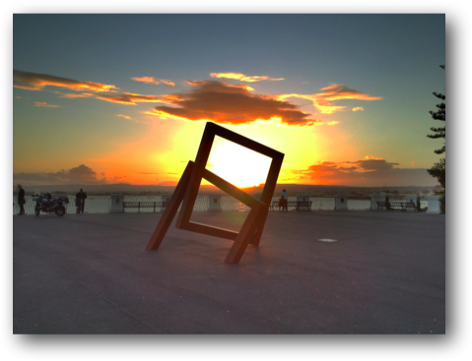
Assignment #1: A Photograph is a Photograph
Ortega, Sicily, Italy
Using an IPhone 4S
(replace this with your own text)

Slide 3
Assignment #2: Epsilon Photography
Objective: take multiple photos of the same scene by varying just a single variable each time, and generate a novel artifact from these images.
My Work: I chose the focus as my epsilon with my baby’s animal friends as the scene. By changing the focus in each image, I am able to generate the final artifact where all the animials are clearly visible.
.

Slide 4
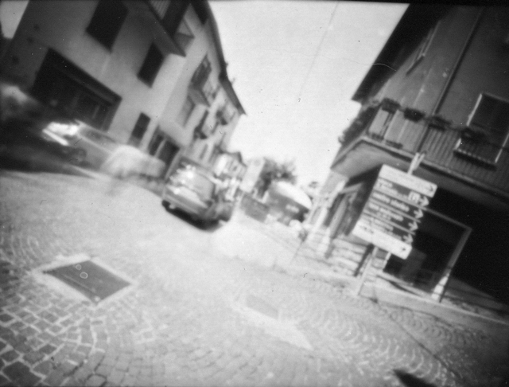
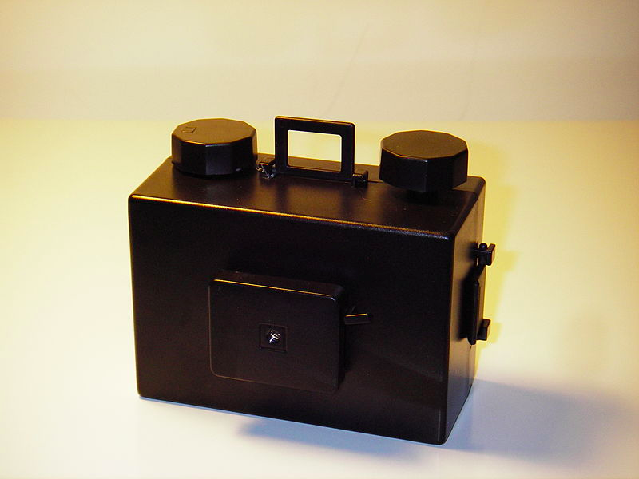
Assignment #3: Camera Obscura
Resulting Image
Setup
Replace with your images...

Slide 5
Assignment #4: Blending
Show your original images and the Final BLENDED IMAGE

Slide 6
Assignment #5: Panoramas
Share whatever you think is appropriate

Slide 7
Assignment #6: HDR
Show the Results from HDR Assignment

Slide 8
Assignment #7: Video Textures
Show the Results from Video Texture Assignment
add working links to host site

Slide 9
Midterm Project
Show whatever is appropriate

Slide 10
Final Project
Details about the project and your goals.
Use figures as appropriate (pipeline?)

Slide 11
Final Project (2)
Show Before and After Images
Links as needed

Slide 12
Anything else
Feel free to add more.
For each assignment, you may add extra pages! Feel free to also improve upon results from any of your assignments and share them in your portfolio.

